Slide 1

Medino Pharmacy
Name: Daisyna Shrestha
NCC-ID: 00172899
Subject: Computing Project
Date: 23rd April, 2019

Slide 2
Introduction
Medino, a web-based pharmacy management system.
Also known as drug information system.
Enable user to access medicine information from anywhere through online and purchase them.
Easy handles data and reduce paper work.
User-friendly and reliable.

Slide 3
Existing system
It requires more paper-work.
Less secure for data storage.
Manual calculation resulting budget error.
Lack of drug knowledge.
Difficulty for user in finding their required medicine.
Less reliable for correct medication

Slide 4
Background of the project
Both pharmacist and user can login into the system with unique email address.
Adding, updating and deleting medicine information are managed by pharmacist.
User can search and view medicine detail and can place their order.
Automated bill generation.

Slide 5
Aims and Objectives
Computerized pharmacy system.
Manage and maintain daily activities of pharmacy.
Secure data processing and storage.
Less paper work.
Overcome manual efforts.
Enhances efficiency.
Easy placing order.

Slide 6
Features of the project - 1
Pharmacist and user login
Store medicine and its related information
Modify and delete medicine
Effective search of medicine
Display extensible list of available medicine
Upload prescription report

Slide 7
Features of the project - 2
Order medicine
Auto generate bill, save and print bill
Record customer order
User-friendly

Slide 8
MoSCoW Prioritization
MoSCoW prioritization is a technique to understand the relative importance of the work to be done.
It helps to make progress and keep deadlines.
And MoSCoW stands for:
Must Have
Should Have
Could Have
Won’t Have this time

Slide 9
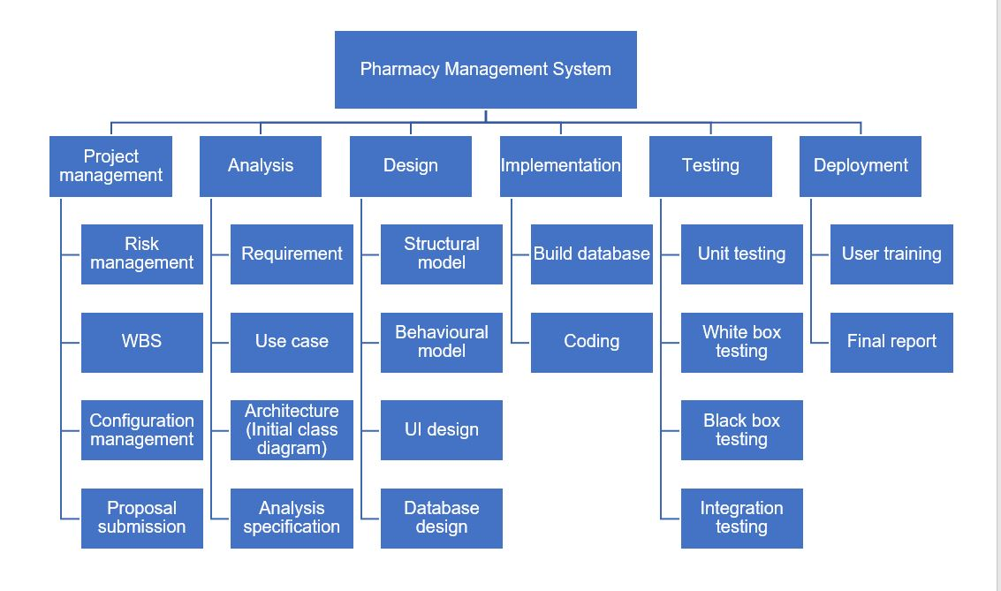
Work breakdown structure

Slide 10
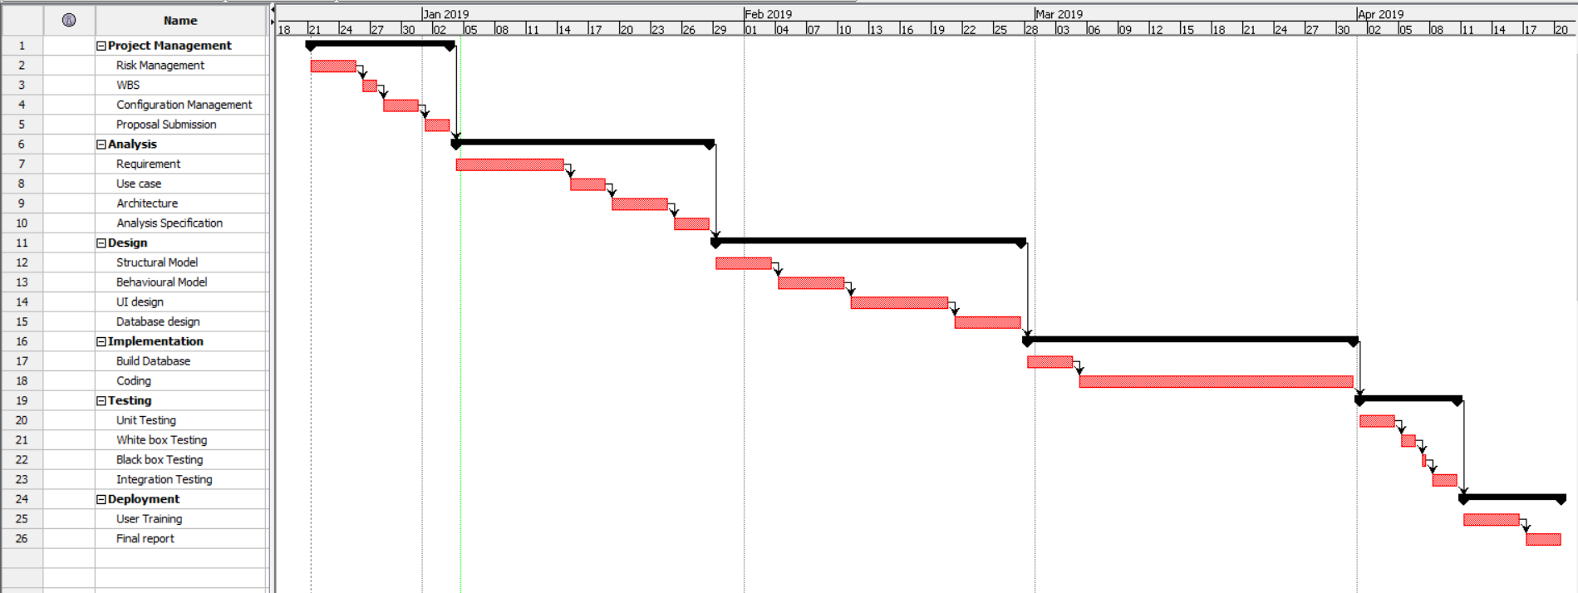
Gantt Chart

Slide 11
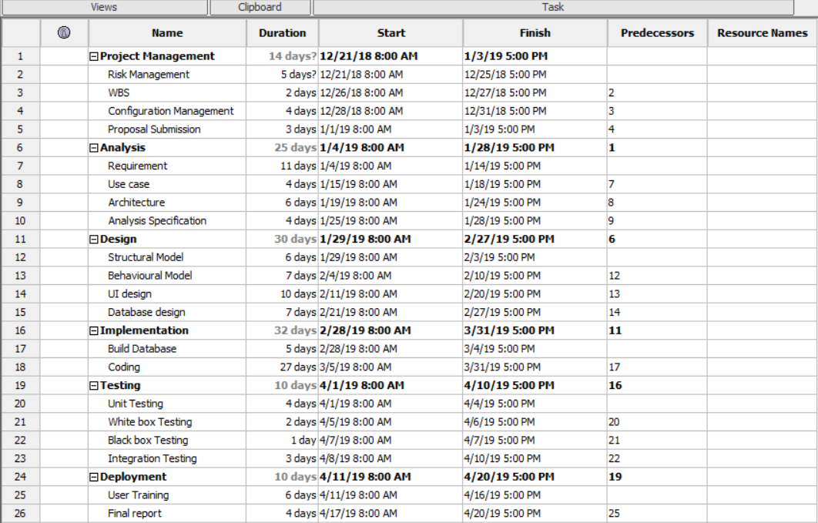
Scheduling

Slide 12
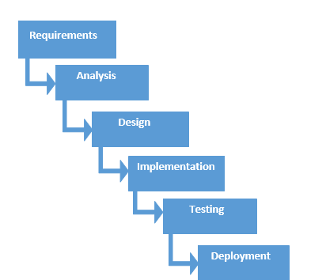
Waterfall methodology
It is linear-sequential software development model in which development is seen as flowing steadily downwards like a waterfall through phases.
Each phase must be completed before beginning another phase.

Slide 13
Why Waterfall ?
It is suitable for small project.
It is easy to understand and simple to use.
It is easy to manage and each phase has specific goals and review process.
It helps to measure project milestone.
It works well where the requirements are clear and understandable.

Slide 14
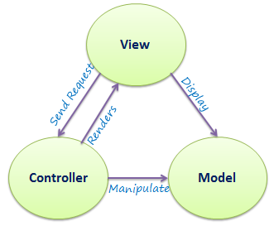
Architecture – 3-tier architecture
MVC architecture is used.
It stands for “Model-View-Controller”.
1. Model
It carries data and can contain business logic used by the program.
2. View
It represents the GUI part with which user will interact.
3. Controller
It controls the data flow into model and update view. It connects user with the system.

Slide 15
Risk management
Identification and prioritization of risks and analyzing with various tools and economical application resources to minimize their impact on the system.
It can be managed in five steps :
1. Identify the risk
2. Analyze the risk
3. Evaluate or rank the risk
4. Treat the risk
5. Monitor and review the risk

Slide 16
Configuration management
A way to maintain consistency between physical and logical assets in an operational environment throughout project life.
Identifies bad configuration changes and ensures quick service restoration.
Why?
Increased efficiency
Cost reduction
Efficient change management
Faster restoration of your service if a process failure occurs.

Slide 17
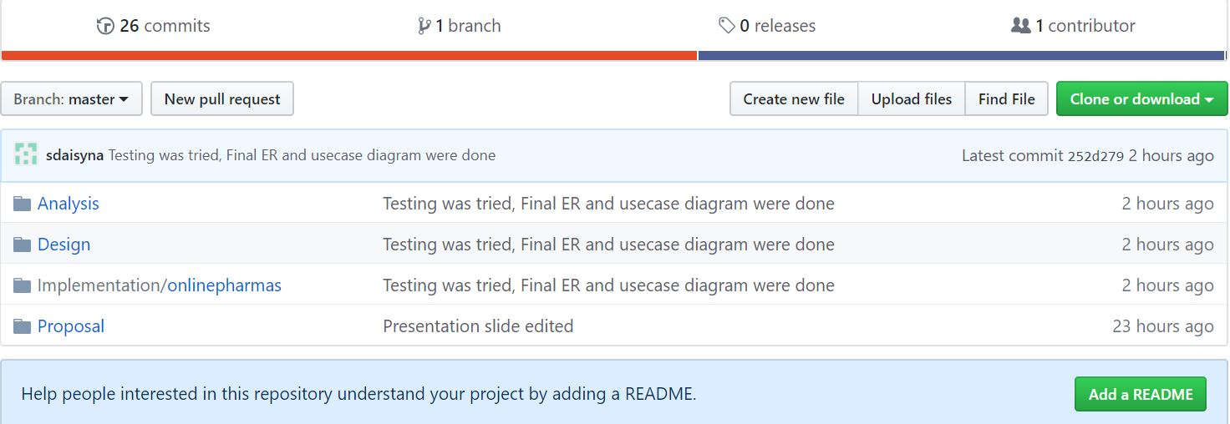

Slide 18
Design – Initial class diagram
The static structure providing the overview of the system through classes and defining the relationships among the classes.

Slide 19
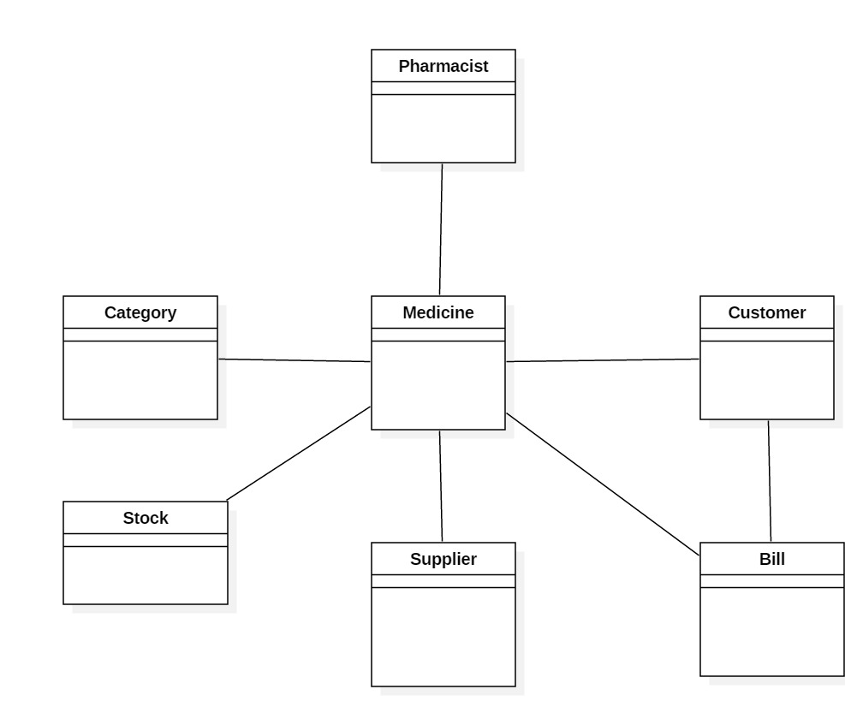

Slide 20
Design – Class diagram
It is a static structure and modelling of the system.
It helps to describe general overview of the system.
Illustrates relationships and dependencies among classes present in the system.

Slide 21
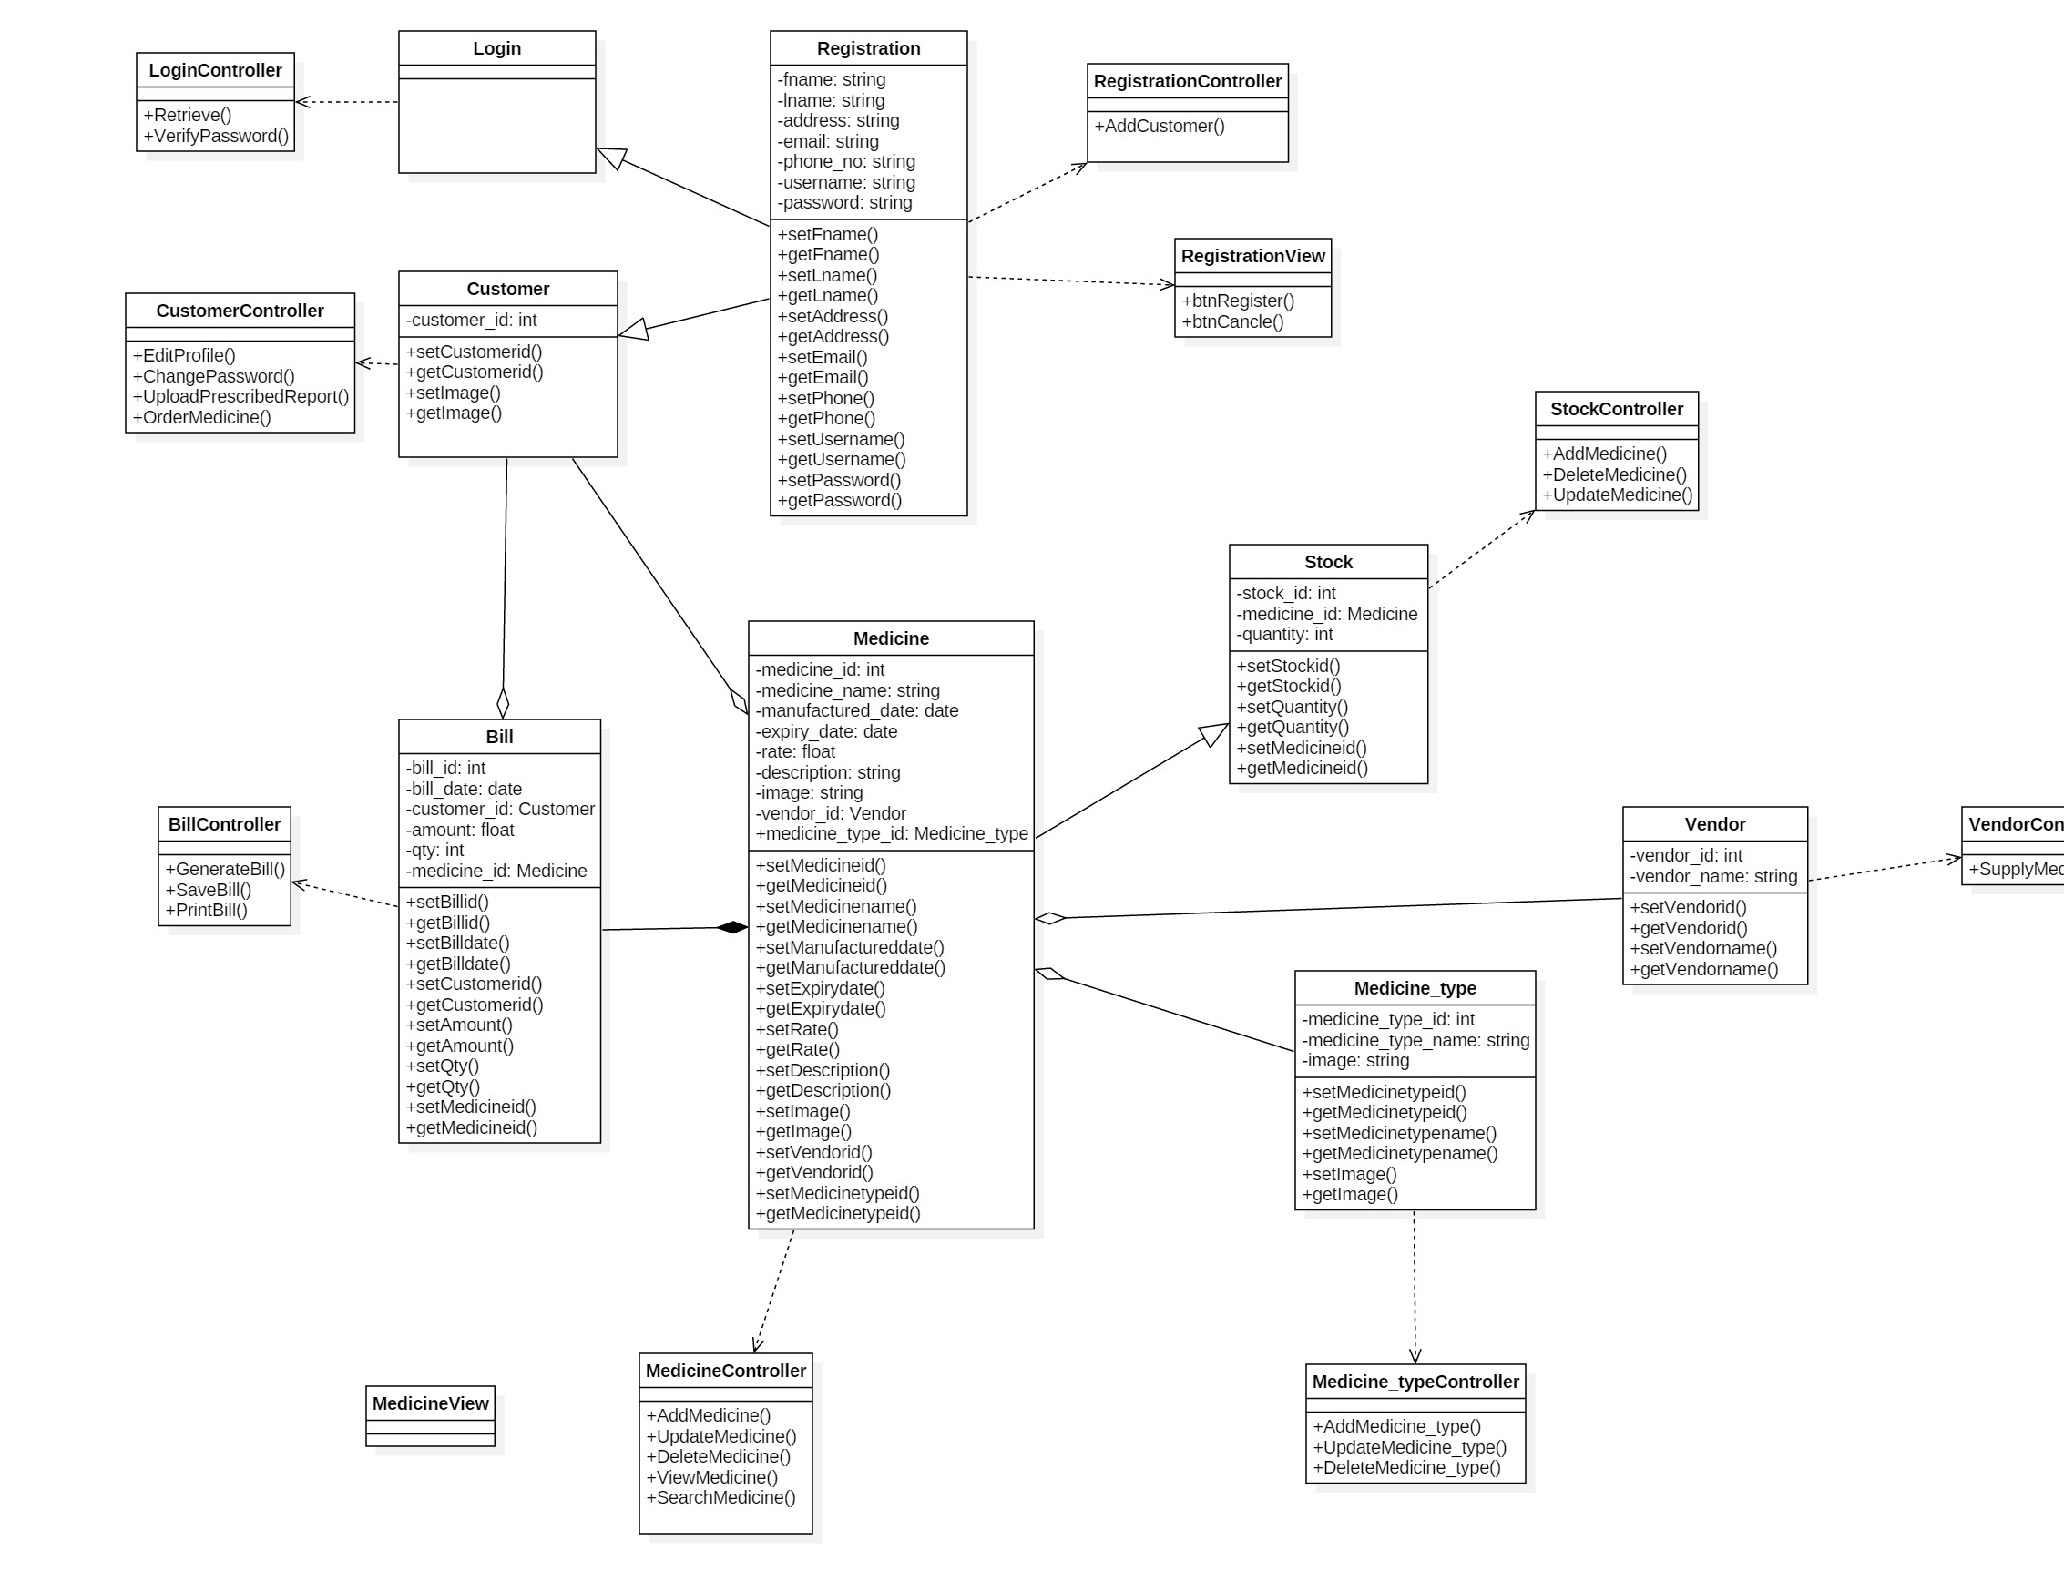

Slide 22
Design – ER-diagram
It is analytical structure of entities

Slide 23
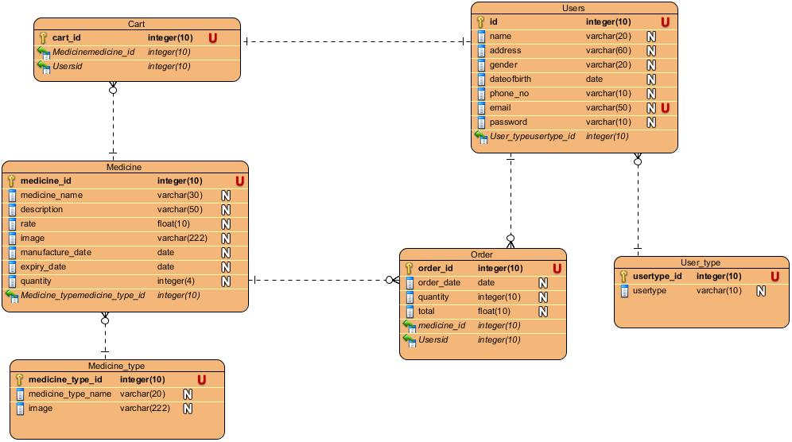

Slide 24
Design – Use case diagram

Slide 25
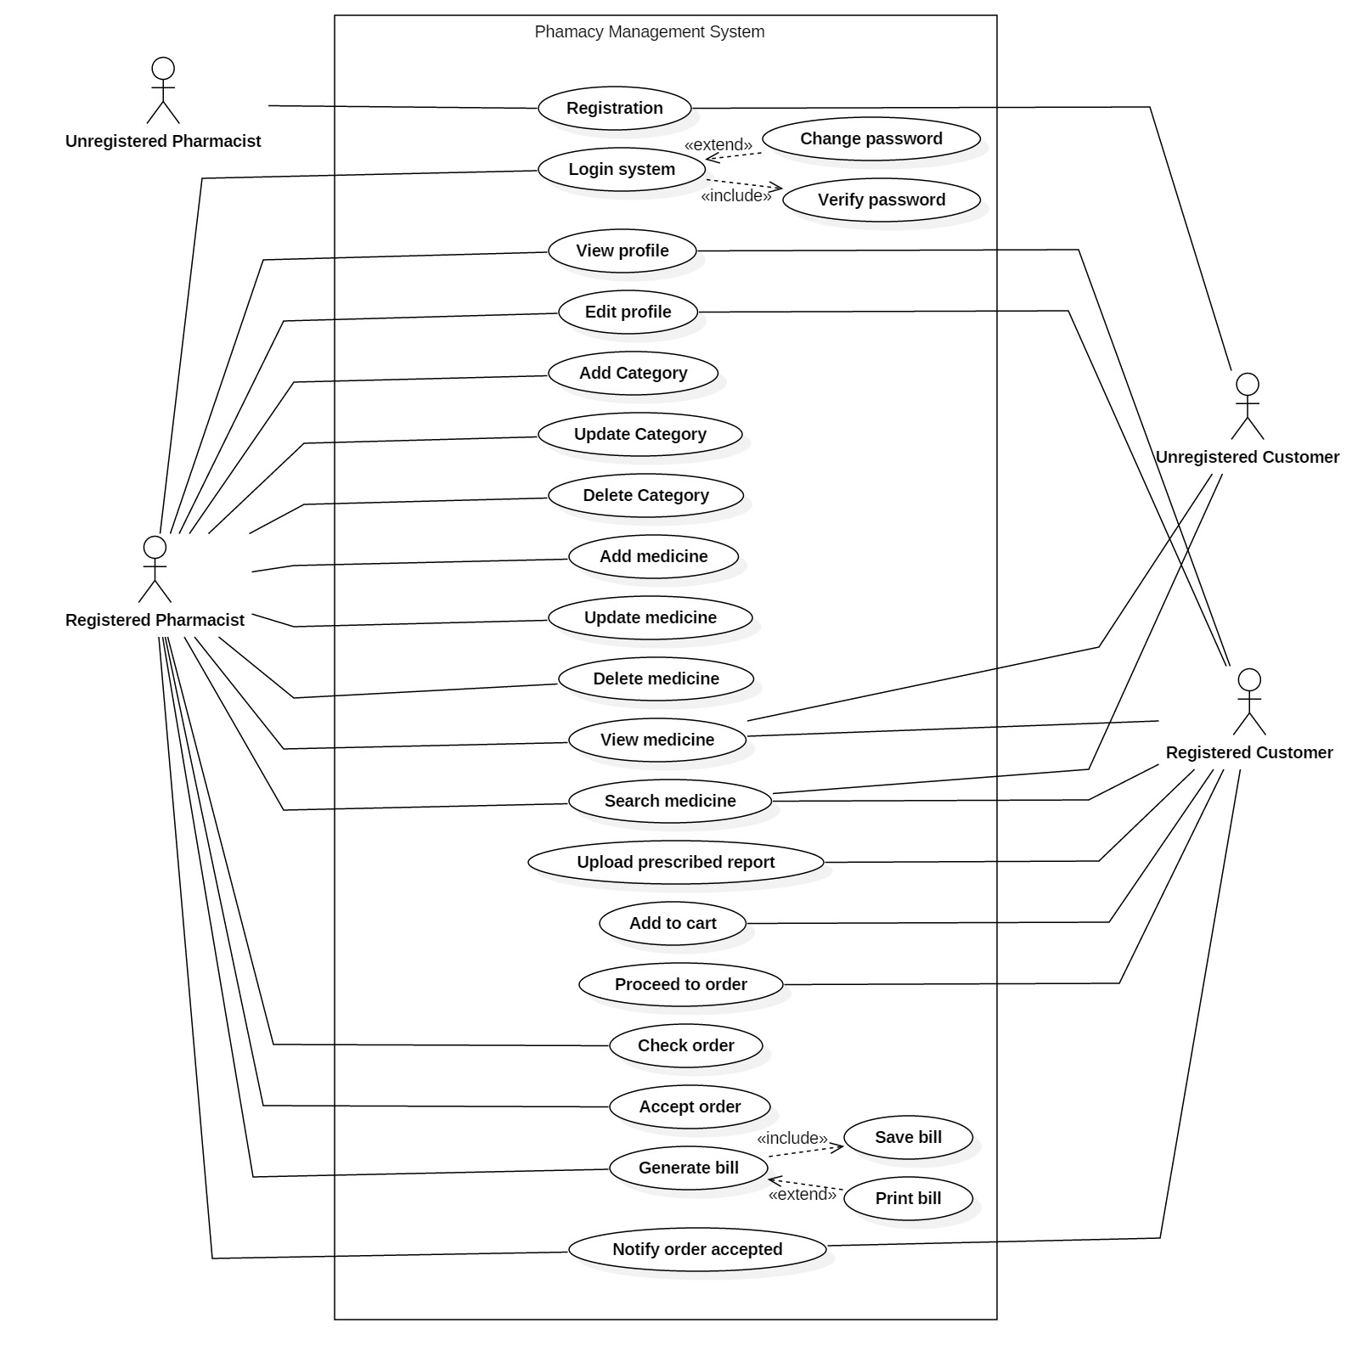

Slide 26
Design – Activity diagram

Slide 27
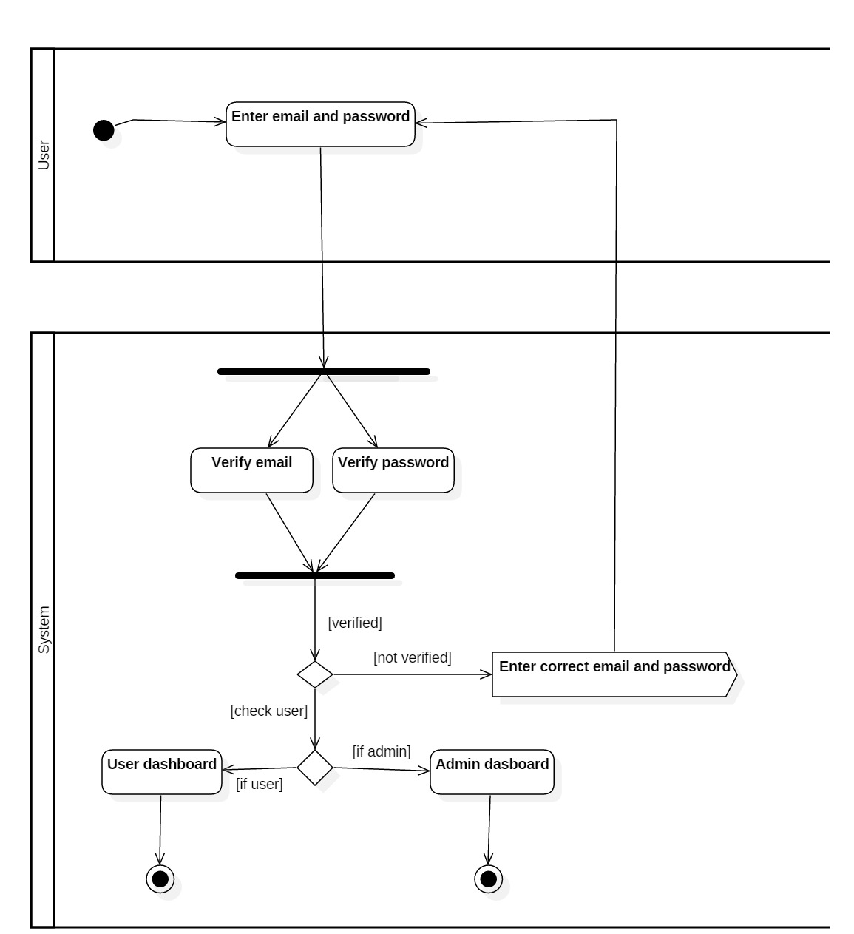

Slide 28
Design – Sequence diagram

Slide 29
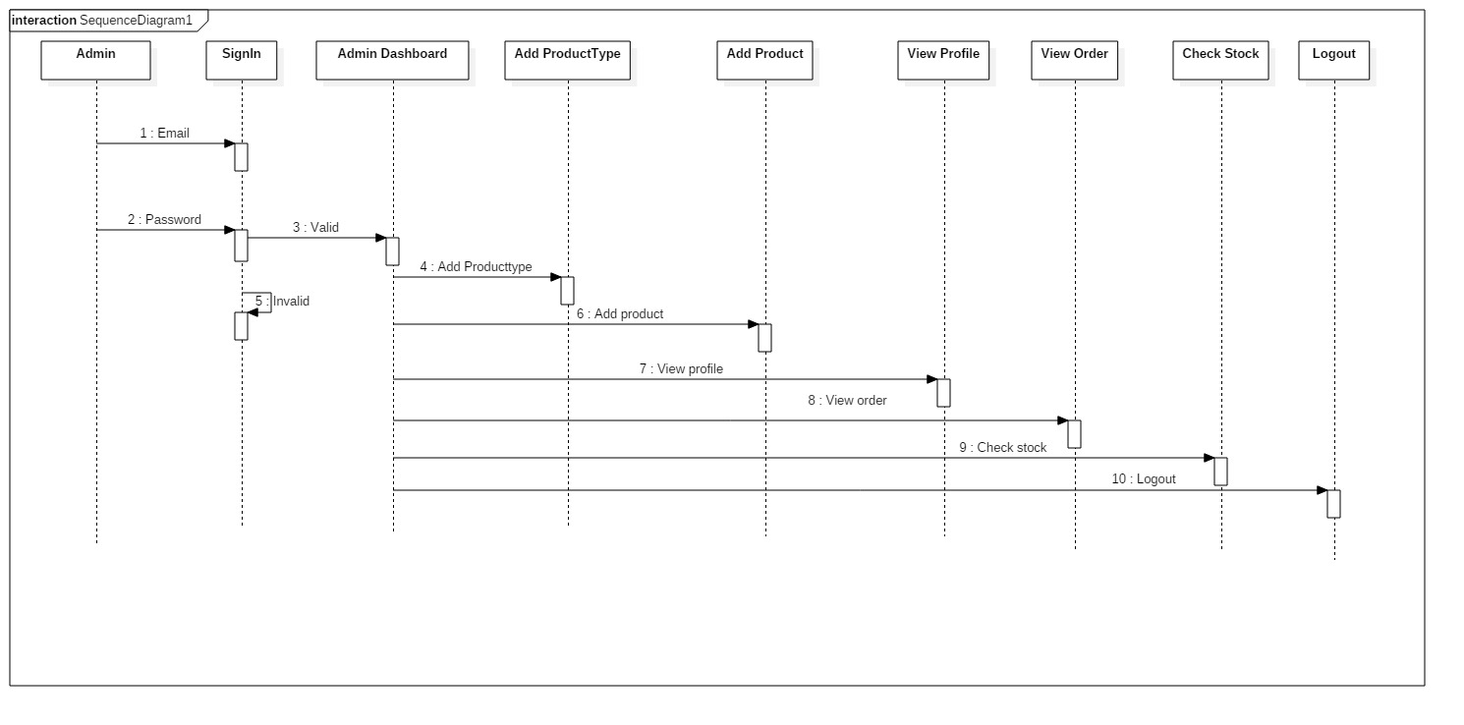

Slide 30
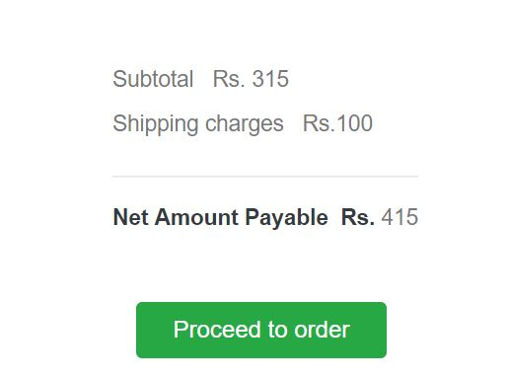
Coding and its UI design

Slide 31
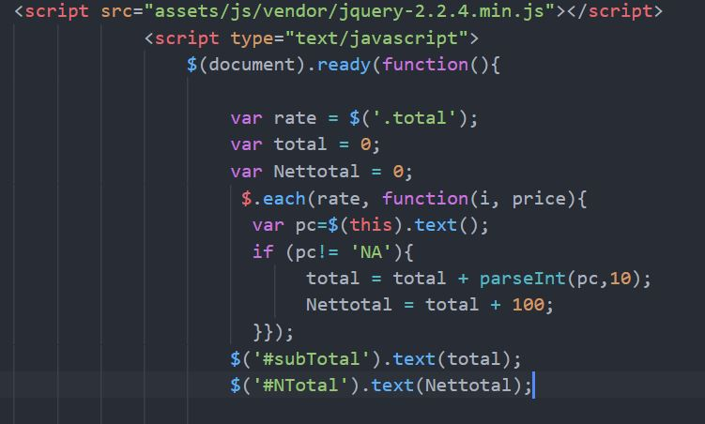
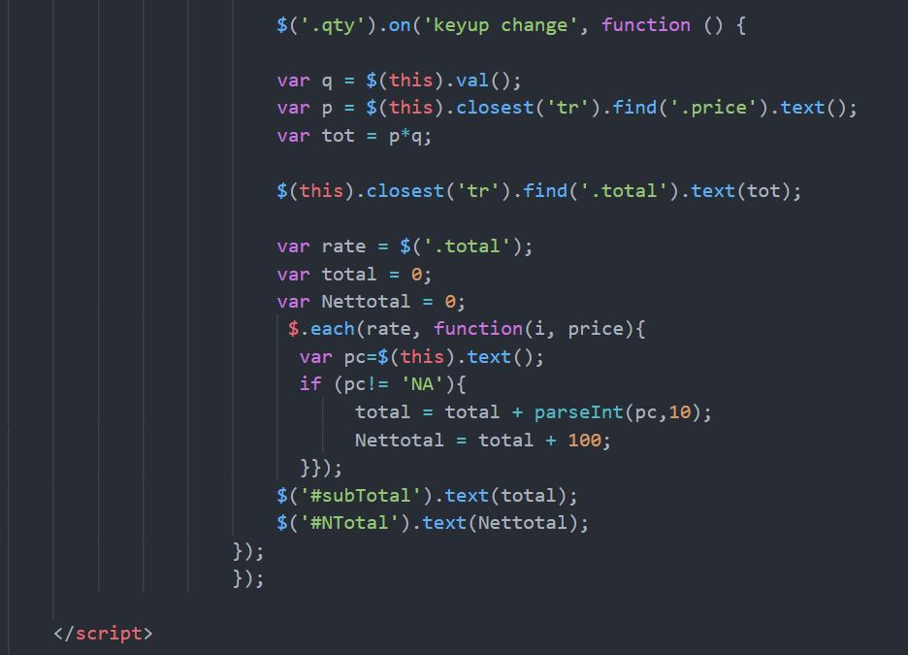

Slide 34
Test cases

Slide 35
Future work

Slide 36
Limitation
Lacks online payment system.
Validation while uploading prescribed report by user.

Slide 37
User manual

Slide 38
Conclusion

Slide 39
References
https://www.interserver.net/tips/kb/mvc-advantages-disadvantages-mvc/
https://www.tutorialspoint.com/sdlc/sdlc_waterfall_model.htm
https://c2sconsultinggroup.com/the-importance-of-configuration-management/
https://www.slideshare.net/HabtamuAsmare/pharmacy-management-system-requirement-analysis-and-elicitaion-document

Slide 40
Any question ?

Slide 41
Thank you !

